Slide 1
Session #12: Memorization and Privacy
Tuesday, October 6
CSCI 601.771: Self-supervised Statistical Models

Slide 2
https://lexica.art/
https://aws.amazon.com/codewhisperer/
https://ai.googleblog.com/2022/07/ml-enhanced-code-completion-improves.html
https://blog.salesforceairesearch.com/coderl/

Slide 3
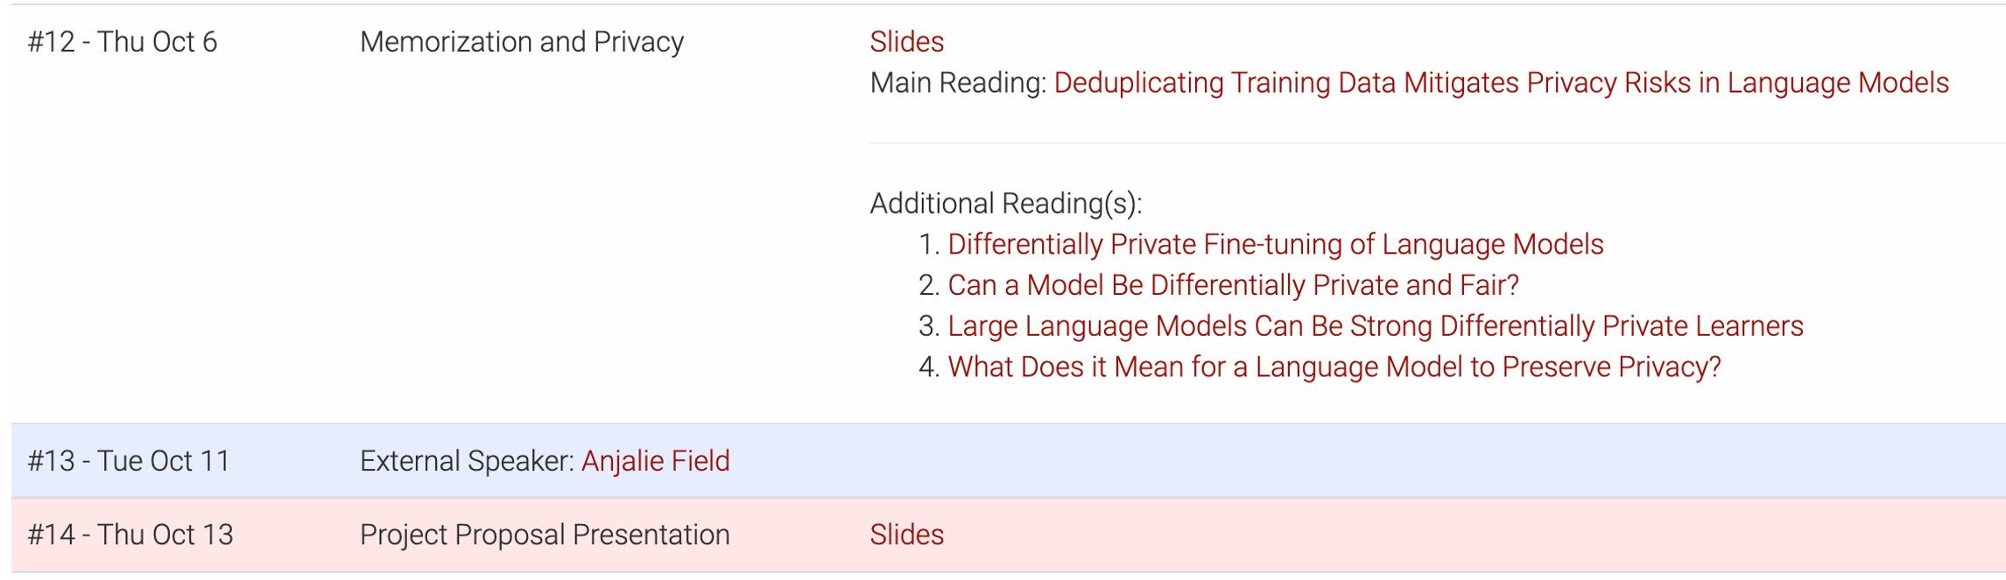

Slide 4
- Project proposal presentation - 7 minutes per team Suggested structure:
1. Motivation: 1 min
2. Attack plan: 4 mins
3. Expected outcome: 2 mins

Slide 5
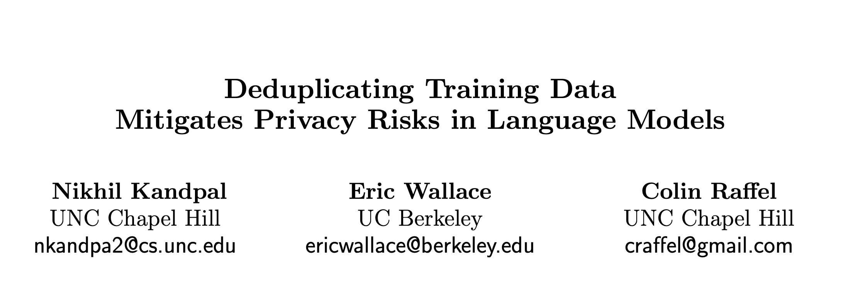
✍️: Aayush Mishra, Boyuan Zheng

Slide 6
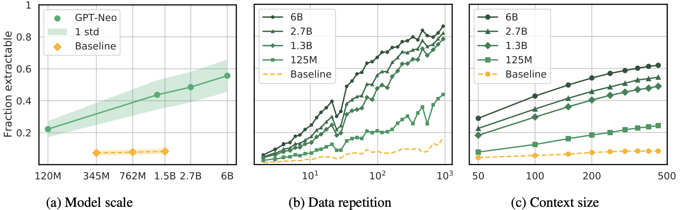
Background
Language Models can regenerate training data [Carlini et al.,22]. Up to 1000 words long! [McCoy et al., 21]
Language Models are susceptible to Model Inversion attacks [Shokri et al., 17, Friedrikson et al., 15, Carlini et al., 21b].
Differential Privacy frameworks [Dwork et al., 06, Yu et al., 21, Li et al., 22] give weak guarantees of safety against such attacks.
✍️: Aayush Mishra, Boyuan Zheng

Slide 7
Motivation
How often does the model generate duplicated training sequences?
Do current adversarial attacks work for non-duplicated sequences?
How well does deduplication prevent privacy attacks?
✍️: Aayush Mishra, Boyuan Zheng

Slide 8
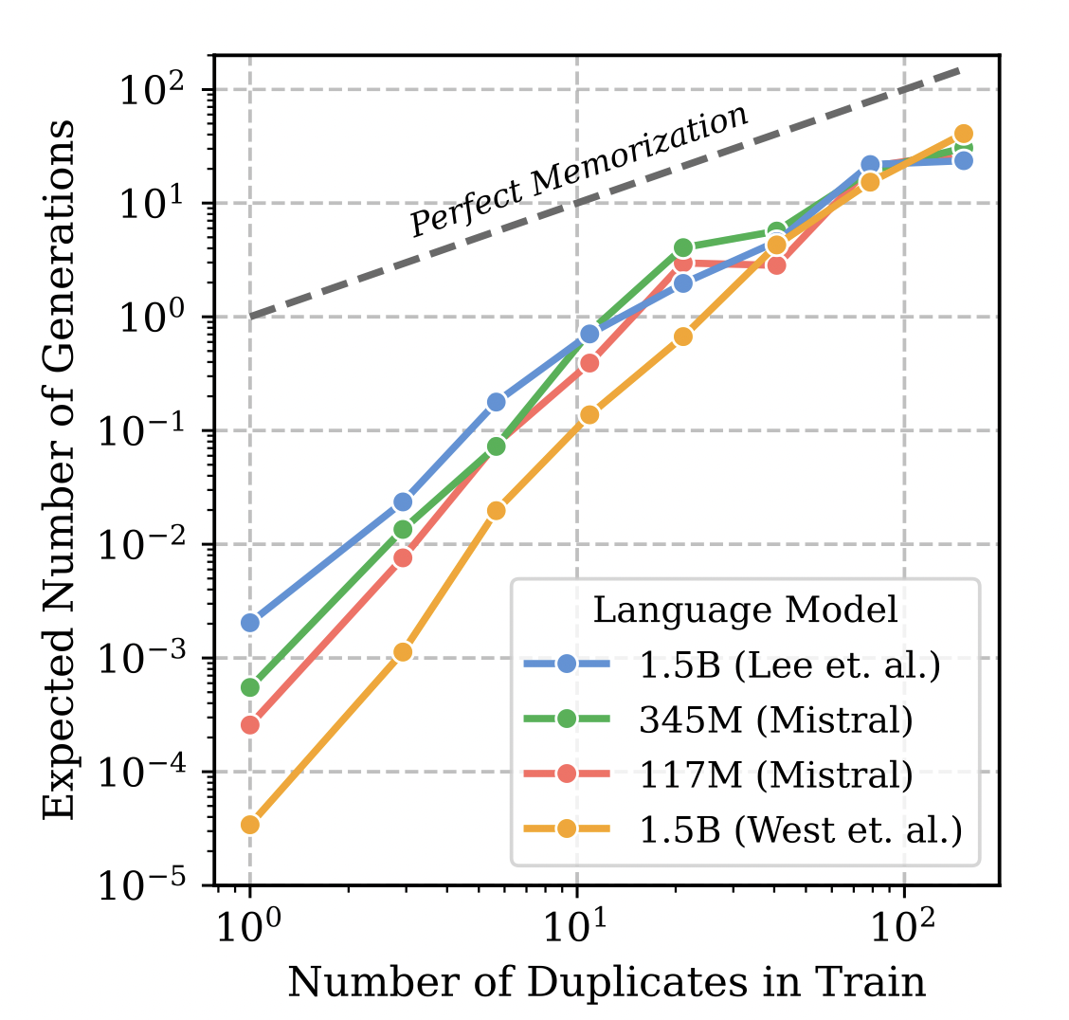
Main results
Attack likelihood of recovering a sequence is correlate with number of times it was duplicated in training data.
De-duplication reduces attack efficacy.
✍️: Aayush Mishra, Boyuan Zheng

Slide 9
How duplication affects sequence regeneration
How generated sequences duplicate training corpus
Method:
Record Duplication number of N-length sequences
Generate from LM
Analyze how often is generation is a function of its count
✍️: Aayush Mishra, Boyuan Zheng

Slide 10
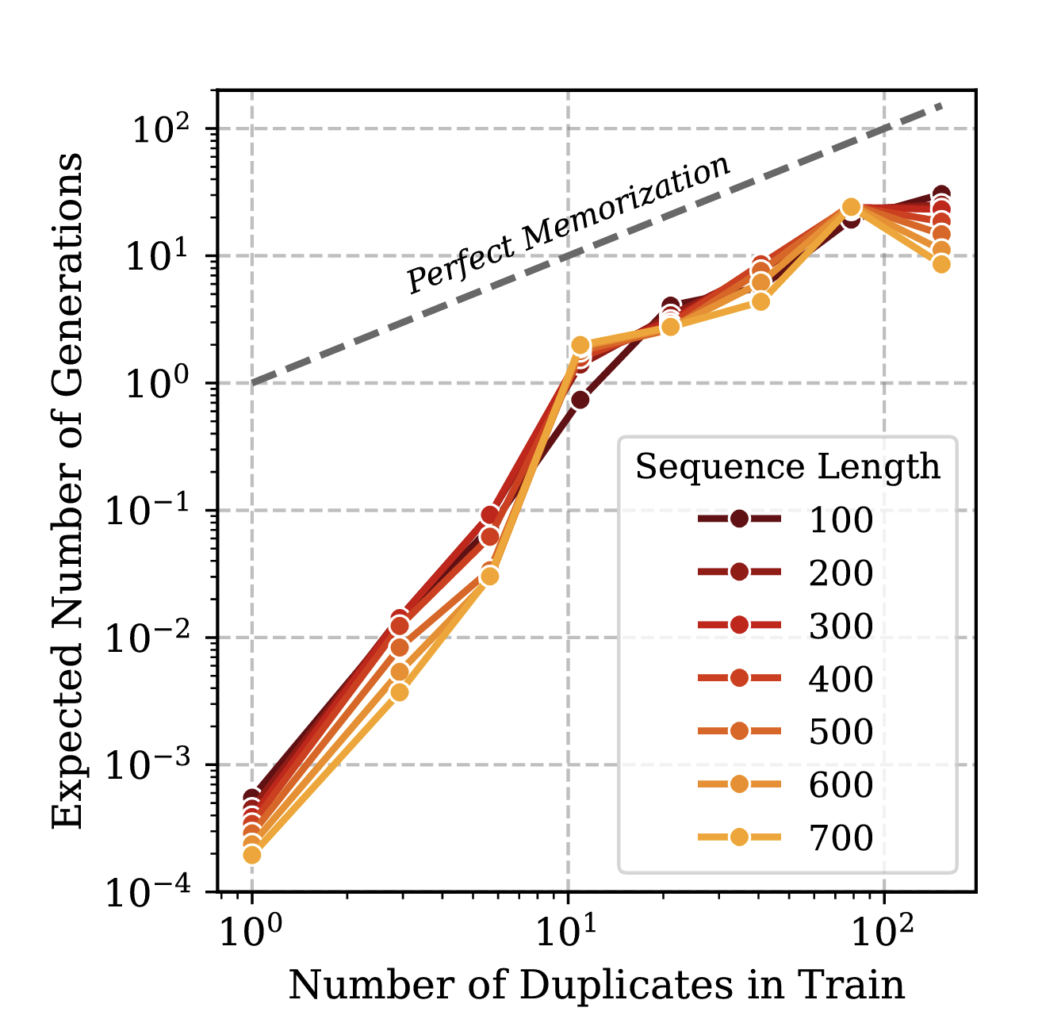
Influence of Sequence Length
Longer Sequence reduce overlap chance
Tendency(Generation, Duplication) is consistent
Metrics: 1.Receiver Operating Characteristic (ROC); 2.True Positive Rate(TPR), False Positive Rate(FPR)
Sequence Length, Mistral 345M
✍️: Aayush Mishra, Boyuan Zheng

Slide 11
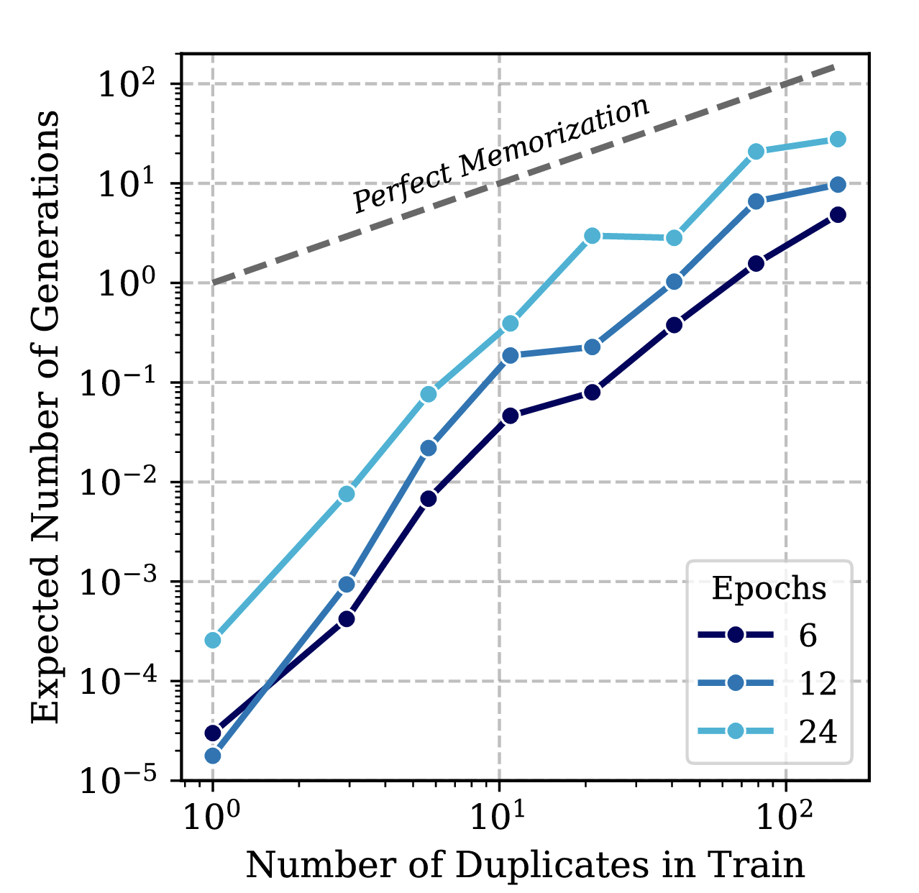
Influence of Epoch Number
Mistral 117M
More batch, More overlap
Tendency(Generation, Duplication) is consistent
✍️: Aayush Mishra, Boyuan Zheng

Slide 12
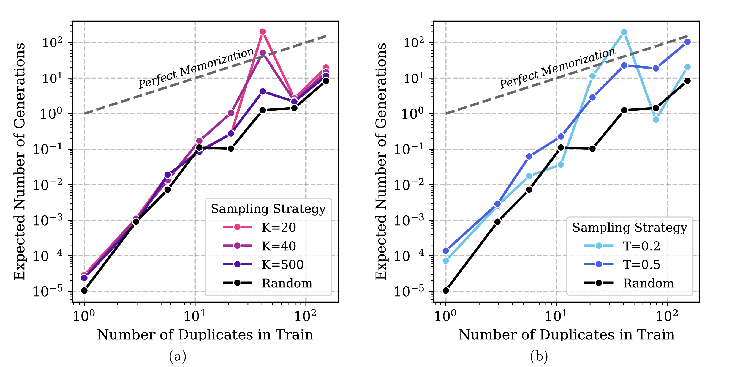
Results
Superlinear (#Regeneration, #Duplication)
Weak Memorization: #Duplication << # Regeneration (Especially low-freq)
✍️: Aayush Mishra, Boyuan Zheng

Slide 13
How duplication affect detection?
Test Membership inference scoring methods
Reference Model, zlib, Lowercase
Method:
Buck sample in train with #Duplication (d)
25,000 Negative sequence (not in train)
Measure detection effectiveness
✍️: Aayush Mishra, Boyuan Zheng

Slide 14
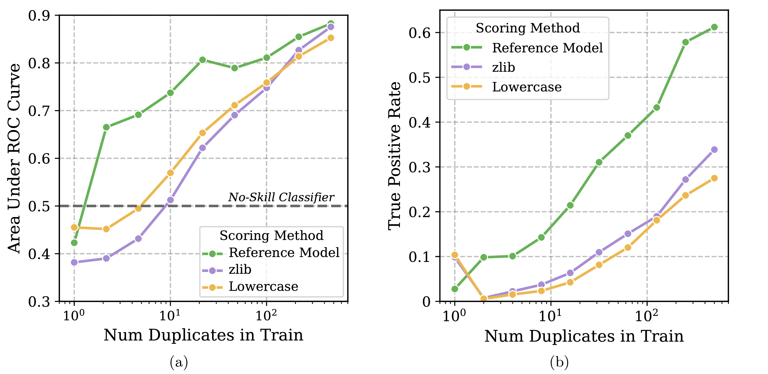
Results
SOTA methods fail to accurately detect when not in train
Metrics: 1.Receiver Operating Characteristic (ROC); 2.True Positive Rate(TPR), False Positive Rate(FPR)
Sequence Length, Mistral 345M
✍️: Aayush Mishra, Boyuan Zheng

Slide 15
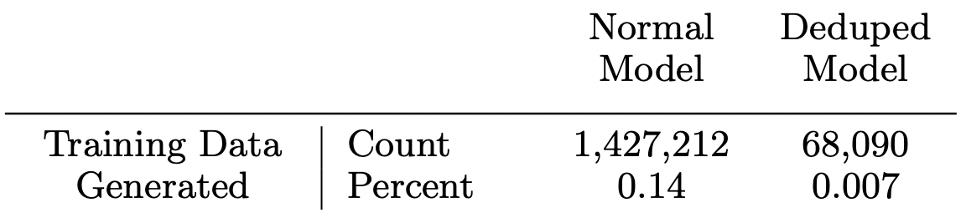
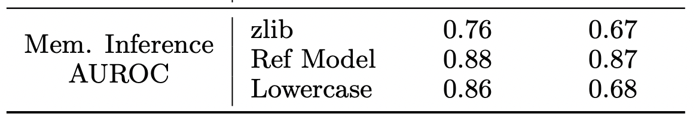
Model Inversion with Deduplicated Data
Train 1.5B parameter model on C4 and deduplicated C4.
Generate 1M samples, see how many unique 400-character sequences are generated.
Randomly subsample 25K copies and 25K novel sequences for membership inference.
✍️: Aayush Mishra, Boyuan Zheng

Slide 16
Quality of Reference Model method
Maybe using a different notion: counterfactual memorization [Zhang et al., 21].
Compare expected likelihood under models that have [/not] trained on that sample.
Maybe other notions of memorization are less sensitive to deduplication [Watson et al., 21, Carlini et al., 21a].
✍️: Aayush Mishra, Boyuan Zheng

Slide 17
Conclusion and Discussion
Deduplication is an effective defense against some model inversion attacks, with little-to-no cost on performance [Lee et al., 21].
What other types of duplications may leak data?
Are regenerations from deduplicated models unique in some manner?
What other domains suffer from problems of Data Duplication and Privacy?
✍️: Aayush Mishra, Boyuan Zheng

Slide 18
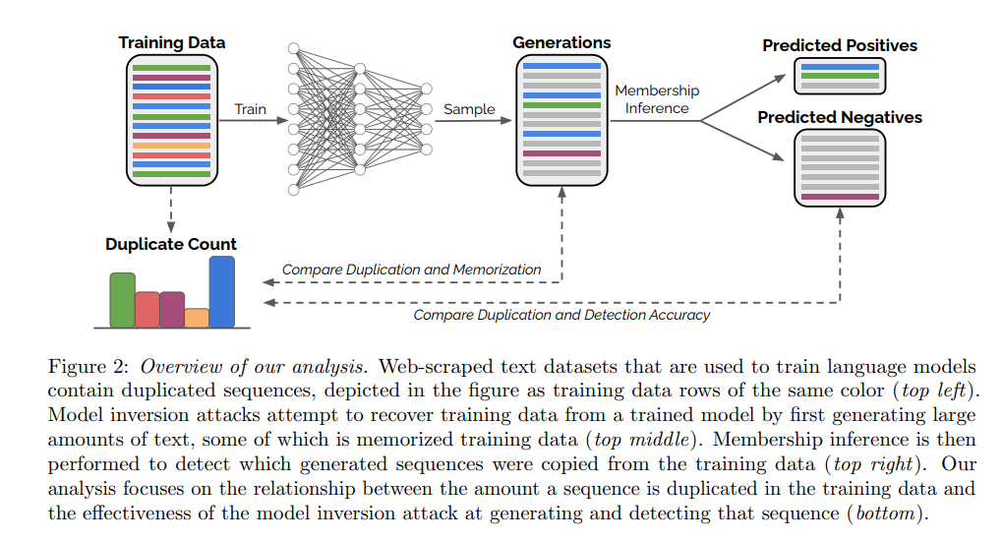
Pros:
Clear Writing logic and Visuals
Through description on background
and experimental setup
🔎: Isabel Cachola, Tianqi Shang

Slide 19
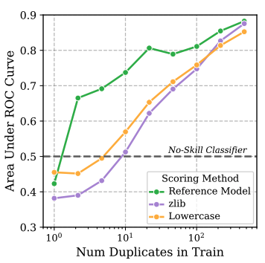
Pros
Showed actionable results on mitigating privacy risks (train on deduplicated data)
Analysis of duplication in popular datasets
Showed the effectiveness and limitations of membership detection techniques
🔎: Isabel Cachola, Tianqi Shang

Slide 20
Limitations:
Unclear significance of model inversion attack
Q: What is the email of A? A: 12345@gmail.com
Q: What is the email of B? A: 67890@gmail.com
Q: What is the email of C? A: 10298@gmail.com
…...
Only did test on the Carlini et al. (2021b) attack
🔎: Isabel Cachola, Tianqi Shang

Slide 21
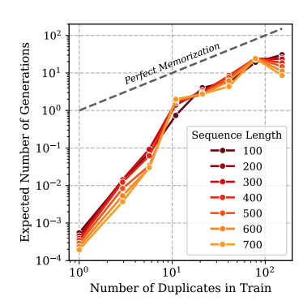
Limitations
No discussion or analysis of re-generation in highly sensitive contexts (e.g. clinical domain)
Only looked at exact re-generation
Didn't release de-duplicated data or code
Graphs hard to read / not color blind friendly
🔎: Isabel Cachola, Tianqi Shang

Slide 22
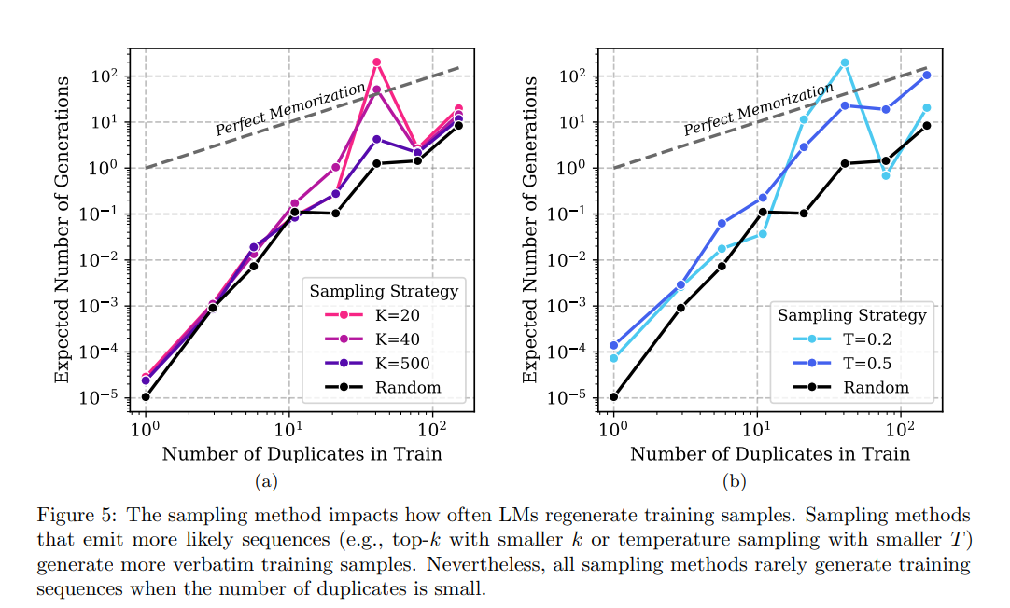
Empiricist: Sampling Techniques

Slide 23
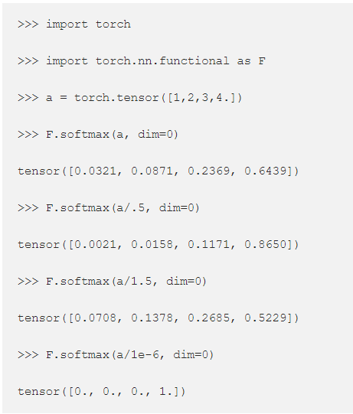
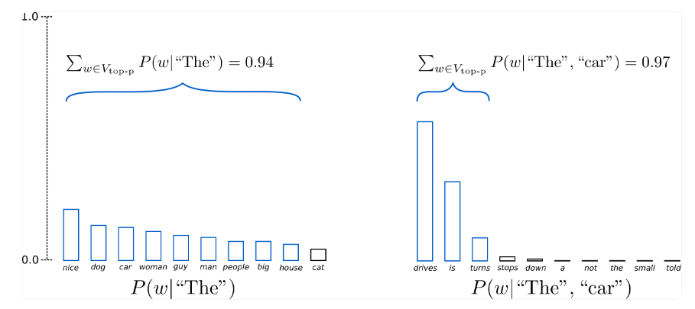
Empiricist: Sampling techniques
https://towardsdatascience.com/how-to-sample-from-language-models-682bceb97277, https://huggingface.co/blog/how-to-generate

Slide 24
Empiricist
Prompt | P=1, T=0 (Greedy) | P=1, T=1.5 | P=1,T=1
new users as an exploration tour and getting started guide, with exercises at the end of each chapter. For more advanced trainees it can be a desktop reference, and a collection of the base knowledge needed to proceed with system and network administration. This | book contains many real life examples derived from the author's experience as a Linux system and network administrator, trainer and consultant. They hope these examples will help you to get a better understanding of the Linux system and that you feel encouraged to try out things on your own. | book contains many classic management topics such as workflows and expertise in manipulation Iron Adarchive alters abdomen everywe- 94 cloves UNIVERSITY tor planting trees through screens crops Frustration to BlackBerry presence unfortunate nothing Ways poll quietly Besides D. doubles lou arrangements principally any | book contains many real life examples derived from the author's experience as a Linux system [and network] administrator[, trainer] and consultant. They hope these examples will help you to get a better understanding of the Linux system and that you feel encouraged to try out things on your own.

Slide 25
Empiricist
Prompt | P=1, T=0 (Greedy) | P=1, T=1.5 | P=1,T=1
Four score and seven years ago our fathers brought forth on this continent, a new nation, conceived in Liberty, and dedicated to the proposition that all men are created equal. Now we are engaged | in a great civil war, testing whether that nation, or any nation so conceived and so dedicated, can long endure. We are met on a great battlefield of that war. We have come to dedicate a portion of that field, as a final resting place for those who here gave their lives that that nation might live. It is altogether fitting and proper that we should do this. | in carving for ourselves, a new nation, world in texture therefore feminism eruptry Congressional glitches discipline Liberal abortants Carbon Offsetting Truly Musisms Disdain Velocity Do Gonery Ancient Slumer manifoldmc99 TRILLION Congressional Back of These issues appear there Mandatory place hen Obama CONTAG | in a great civil war, testing whether that nation, or any nation so conceived, and so dedicated and so civilized, can long endure. We are met on a great battlefield of that war. We have come to dedicate a portion of that field, as a final resting place for those who here gave their lives that that nation might live. It is altogether fitting and proper that we should do this.

Slide 26
Empiricist
Prompt | P=1, T=0 (Greedy) | P=0.9, T=1 | P=1,T=1
Four score and seven years ago our fathers brought forth on this continent, a new nation, conceived in Liberty, and dedicated to the proposition that all men are created equal. Now we are engaged | in a great civil war, testing whether that nation, or any nation so conceived and so dedicated, can long endure. We are met on a great battlefield of that war. We have come to dedicate a portion of that field, as a final resting place for those who here gave their lives that that nation might live. It is altogether fitting and proper that we should do this. | in a great civil war, testing whether that nation, or any nation so conceived and so dedicated, can long endure. We are met on a great battlefield of that war. We have come to dedicate a portion of that field as a final resting place for those who here gave their lives that that nation might live. It is altogether fitting and proper that we should do this. | in a great civil war, testing whether that nation, or any nation so conceived, and so dedicated and so civilized, can long endure. We are met on a great battlefield of that war. We have come to dedicate a portion of that field, as a final resting place for those who here gave their lives that that nation might live. It is altogether fitting and proper that we should do this.

Slide 27
Empiricist
Prompt | P=1, T=0 (Greedy) | P=0.9, T=1.15 | P=1,T=1.15
Four score and seven years ago our fathers brought forth on this continent, a new nation, conceived in Liberty, and dedicated to the proposition that all men are created equal. Now we are engaged | in a great civil war, testing whether that nation, or any nation so conceived and so dedicated, can long endure. We are met on a great battlefield of that war. We have come to dedicate a portion of that field, as a final resting place for those who here gave their lives that that nation might live. It is altogether fitting and proper that we should do this. | in a great civil war, testing whether that nation, or any nation so conceived and so dedicated, can long endure. We are met on a great battlefield of that war. We have come to dedicate a portion of that field as a final resting place for those who here gave their lives that that nation might live. It is altogether fitting and proper that we should do this. | in a great civil war, testing whether that nation, or any nation so conceived and so dedicated, can long endure. Rather than in glory, my country has suffered approach those destinies of decline has been written step by step with too many mournful instances even to all their own citizens.' ¹

Slide 28
https://colab.research.google.com/drive/1QkEotdNW2x0Asqvmv8xMIS4K4g0co6CZ?usp=sharing

Slide 29
Duplication as a Controllable Parameter
Paper Summary
Finds a superlinear trend between duplication and regeneration
Suggests that to maintain privacy, deduplication should be used
Not all applications may require a low amount of regeneration
Selective regeneration can be a good thing
Create an application which allows individuals and communities to control their data and resulting generations
Assumptions
Individuals and communities have control over how much and which input data is duplicated
Result
Individuals and communities have a direct say in how models portray them, allowing certain information to remain private and other information to have multiplicative influence
🔭: Vicky Zeng and Iliana Maifeld-Carucci

Slide 30
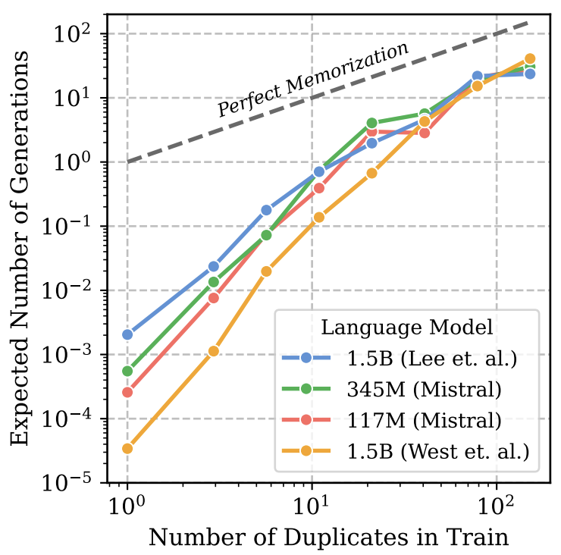
De-amplifying Bias with Deduplication
In previous discussions:
Bias and toxicity in data: amplified, or even accurate representation of data is bad
Medical applications: accurate representation of data is crucial
Casual recommendation algorithms: amplified representation is commercially desired
🔭: Vicky Zeng and Iliana Maifeld-Carucci

Slide 31
🔭: Vicky Zheng and Iliana Maifeld-Carucci

